Slide 1
Session Seven
Respond, Don’t React
ARC Reflections

Slide 3
ARC Reflections
ARC, or Attachment, Regulation and Competency, is a framework for working with children and teens who have experienced trauma. Developed by Margaret Blaustein and Kristine Kinniburgh of the Justice Resource Institute, ARC builds on the resilience of children, teens and families
ARC Reflections — an ARC-informed caregiver training curriculum for foster parents, kin and other caregivers — was written by Blaustein and Kinniburgh with support and consultation from the Annie E. Casey Foundation

Slide 4
Welcome
This group will meet nine times for two hours each time
Please attend all sessions
Each session will include the following segments:
Warm-up
Opening check-in
Review and report back
Theme of the day
Self-reflection
Take home
Practice
Closing check-in

Slide 5
WARM-UP

Slide 6
Count Up
How many people are in the room? Your goal is to cooperatively count to that number, out loud, as a group
Any person can start; any person can say a number — but only one person can say a number at a time
If more than one person says a number, you must start over
How many tries does it take to be successful?

Slide 7
OPENING CHECK-IN

Slide 8
What Is Your Energy Right Now?
Totally Comfortable
z
Great Match
+10
+5
0
-5
-10
Really Uncomfortable
Terrible Match

Slide 9
Getting Comfortable
If your energy is comfortable and a good match, great!
If not, what can you do to get it there?

Slide 10
REVIEW AND REPORT BACK

Slide 11
Review
Remember how infants and young kids learn how to regulate
It is much harder for kids and teens who don’t have enough soothing when they are young to manage feelings and behavior
To help:
Lay a good foundation. Use routines and other ongoing, soothing strategies. Connect with the child or teen and learn his or her patterns
Respond in the moment. Read clues, use your self-care tools, support the child using his or her tools, offer opportunities for control and reconnection

Slide 12
Report Back
In small groups, discuss what you practiced
What went well?
What was challenging?
What was something you noticed?

Slide 13
RESPOND, DON’T REACT

Slide 14
Remember These?
In an earlier session, we identified challenging behaviors you encounter at home
Are there other behaviors you want to add to the list?
Do these behaviors still feel as challenging? Why or why not?
What are some of your typical responses? What strategies do you use to try to address these behaviors?

Slide 15
Children’s Behavior Can Be Hard
Many young people who have experienced trauma struggle with behaviors that challenge us, push our buttons, are hard to redirect and may feel disruptive to home life
You may feel your strategies are maxed out, especially when what works with one child or teen does not work with another and what worked yesterday doesn’t work today

Slide 16
Why Are Some Behaviors So Hard to Change?
Remember the sequence that drives the behaviors:
Lens: The world is dangerous
Function: Survival
Ability to respond: Too few internal or external resources
Nothing is as hard to change as the behaviors we develop to help us survive

Slide 17
Adult Responses Are Hard to Shift, Too
What are some of your core values and household expectations?
Consider: Respect, courtesy, honesty, patience, appreciation
Negative child or teen behavior often leads adults to believe children or teens are disrespectful, don’t appreciate and don’t value our relationships
Caregivers can then get caught in emphasizing appropriate behavior in an attempt to teach values

Slide 18
Understanding Children’s and Teens’ Needs and Values (Ours, Too)
NEEDS
VALUES
Self-actualization
Growth, potential, exploration
Esteem
Achievement, respect, independence
Love and belonging
Community, relationships
Safety
Survival, avoiding danger
Physiological (bodily needs)
Survival, fulfilling core needs
Adapted from Maslow’s Hierarchy of Needs (1943)

Slide 19
Understanding Children’s and Teens’ Needs and Values (Ours, Too)
NEEDS AND VALUES
BEHAVIORS
Growth, potential
Trying new things, experiencing success
Respect, achievement
Reciprocity, independence
Community, relationships
Cooperation, gratitude, engagement
Survival, danger avoidance
Aggression, running away, lying, tantrums
Physiological (bodily needs)
Stealing, hoarding, sexualized behavior
Adapted from Maslow’s Hierarchy of Needs (1943)

Slide 20
Toolbox: Approaches to Behavior
Be proactive
Identify the child’s or teen’s patterns
Use your go-tos:
Meet needs
Purposefully identify your other strategies, such as praise and reinforcement, problem solving and limit setting
Support regulation

Slide 21
Checking In With Olivia
Olivia is 7 years old. She continues to steal small items and hoard food in her new foster home
She can be affectionate with her foster parents, but gets overwhelmed, clingy and demanding when asked to do small tasks. At times, her anger increases and she throws things at her foster mother
She appears to be settling into her new bedtime routine but has a hard time separating at lights out and her anxiety can escalate, which can spur a lengthy tantrum

Slide 22
Be Proactive
Children or teens who have experienced trauma are complex
They may have challenging behavior
They may have different states
Their responses in relationships may be uneven

Slide 23
Ways to Be Proactive
Identify a limited number of behaviors (no more than three) to focus on
Consider positive behaviors — those you want to see more of — not just those you want to reduce
Olivia’s foster parents decide to focus on those that were most challenging to them:
Hoarding
Bedtime separation
Throwing objects

Slide 24
Identify the Child’s or Teen’s Patterns
Use your detective skills: Read the clues that tell you about your child’s or teen’s needs, feelings and experiences
Remember the function of children’s and teens’ trauma-driven behavior:
Survival (fight, flight, freeze, submit)
Need fulfillment (emotional, relational and physiological needs)

Slide 25
Thinking About Olivia
What needs might be behind Olivia’s:
Hoarding?
Bedtime separation anxiety?
Throwing objects?

Slide 26
What Might Olivia’s Needs Be?
Hoarding
Is it about fulfilling a need? Does she fear not having enough to eat? Is it a survival strategy?
Bedtime separation anxiety
Does she need relational reassurance? Is she afraid of the dark or of being alone — or does she worry her foster parents won’t be there when she wakes up? Does she have difficulty with transitions?
Throwing objects
Is this a survival response? An attempt to get attention or help, or create space for herself?

Slide 27
Use Your Go-Tos: Meet the Child’s Needs
Once laid down by trauma, needs are experienced on a deep level and may need to be met many times, in many ways, for the need to decrease
Meeting needs does not mean you cannot address behaviors in other ways and it does not reinforce the negative behaviors: it gets in front of them and, ideally, decreases the behaviors
Once you identify a child’s or teen’s needs, experiment with ways to meet them

Slide 28
Meeting Olivia’s Needs
Every time Olivia’s foster parents cleaned, they found old, uneaten, often rotten food in drawers and behind the bed. Establishing consequences was not effective
Working with Olivia’s therapist, her foster parents:
Identified a kitchen drawer and filled it with healthy snacks. They made it Olivia’s drawer; only she could take food from it. They regularly made sure it was full
Put a food-safe garbage can in her room for any food-related products
Stopped talking about the issue

Slide 29
Meeting Olivia’s Needs
Throwing objects was often the result of a request for Olivia to complete simple chores or self-care. When Olivia escalated, it was hard for her foster parents not to do the same thing
Olivia’s therapist guessed throwing might be a request for support, not distance
As an experiment, Olivia’s foster mom began to do chores with her. She’d ask, “Olivia, which toys should we pick up first?” Eventually, Olivia was able to complete many tasks independently when her foster mother was in the room and available

Slide 30
Use Your Go-Tos: Support Regulation
Sometimes, your first clue that a need is not being met is dysregulation — a signal that the child’s or teen’s brain has begun to shift into survival mode
At this point, your primary goal is to support regulation and shift the child or teen (and yourself, if necessary!) out of survival mode and into a more regulated state (off of the Express Road and back to the main road)
A “regulation break” may be enough to shift negative behaviors before they have a chance to start

Slide 31
Use Your In-the-Moment Tools to Support Regulation
As a reminder, use your in-the-moment skills in moments of escalation:
Catch the moment as early as possible
Check in and use your own self-regulation tools
Be a mirror
Meet the child’s or teen’s need (if you can identify it)
Offer control and choices
Reconnect

Slide 32
Target Your Use of Strategies Purposefully
Think about the strategies in your behavioral toolbox and use them purposefully. Ask, which is appropriate to the moment?
Think of your strategies as experiments. Understand that one strategy will not work for all kids all the time
Multiple strategies can be used to address the same behavior at different times
Over the next several slides, we will discuss three possible behavioral strategies

Slide 33
Praise and Reinforcement
Why use praise and reinforcement?
To build children’s and teen’s awareness of their successes and positive capacities
To focus yourself on a child’s or teen’s strengths and potential for success rather than focusing on their bad behavior
When should you use praise and reinforcement?
Any time a child or teen is engaging in a behavior you want to increase (often, the opposite of what you want to decrease)

Slide 34
Praise and Reinforcement
How should you use praise and reinforcement?
Use words. Be specific. Label the behavior
“I am so proud of you for using your tools to calm down”
“You did such a good job listening when I asked you to clean up”
Show pride and appreciation (nonverbally)
Use reinforcement charts or concrete rewards

Slide 35
Praise and Reinforcement: Trauma Considerations
Praise can be a trigger for some children or teens who have experienced trauma
If a child or teen rejects or ignores your praise, try not to take it personally and don’t engage in a power struggle
If a child or teen seems triggered by praise, try focusing on the positive behavior instead of the whole child (“You worked so hard on that drawing” vs. “What a good artist you are”)
Keep noticing the positives. Even for a child or teen who seems distressed or unresponsive, over time the positives will matter

Slide 36
Problem Solving
Why engage children and teens in problem solving?
To build children’s and teens’ awareness of having and making choices — and learn that they can get in front of, not just react to, some challenges
To help children and teens feel more in control of and powerful over their lives
When can children and teens be engaged in problem solving?
When children and teens are calm, before or after situations in which challenges are likely or have occurred
When the child or teen is asking you for help
Regularly. Build children’s and teens’ skills by practicing and addressing the many small challenges that arise day to day

Slide 37
Problem Solving
How can children and teens be engaged in problem solving?
Share your interest in supporting the child or teen and your belief in a solution (“Let’s figure this out”)
Help the child or teen identify the problem (“What is it you are trying to solve?”)
Identify goals or desired outcomes (“What do we want to happen?”)
Identify choices (“What different things can we do?”)
Identify consequences (“What might happen if we do that?”)
Make a plan and be a troubleshooter. Stay in the adult support role

Slide 38
Problem Solving: Trauma Considerations
A child’s or teen’s ability to engage in problem solving depends on:
Whether he or she feels powerful enough to make a choice, or believes he or she has one
Which part of the brain is online
His or her stage of development
Your ability to be calm and use this approach at appropriate times — and provide ongoing support — are crucial. Very few children or teens can problem solve independently

Slide 39
Limit Setting
Why use limit setting?
To establish an understanding of boundaries, expectations and a safe world
To help children and teens contain and shift negative behaviors and identify positive alternatives
To help children and teens learn where the lines are with inappropriate behaviors
When should you use limit setting?
When a child’s or teen’s behavior crosses established boundaries related to safety, harm to others or harm to the child or teen
Thoughtfully and not for every behavior

Slide 40
Limit Setting
How to set limits?
When you are calm, if possible
Identify thoughtful, age-appropriate limits in advance of behavior occurring
If you name consequences for certain behavior:
Do so when the child or teen is reasonably calm
Less is more. Be concise and clear; link consequences to the behavior, not the child or teen
Move on when you can. Allow the child or teen to be angry about a consequence but also create space for relationship repair. Use your own self-care tools

Slide 41
Limit Setting: Trauma Considerations
Any limit can be a potential trigger for a child or teen who has experienced trauma
Choose consequences carefully. Time-out may not be the right approach for a child or teen with a neglect history; yelling may trigger a child or teen who has experienced violence
Tune into your child or teen to name feelings, even as you set limits (“It makes sense that you were angry, but we use our words, not our hands, when we are mad”)
Separate the behavior from the child or teen

Slide 42
Problem Solving
Behavior: Throwing things at foster mom when overwhelmed
Olivia’s foster mother sat with Olivia when she was calm during their evening chat time. They talked about how everyone in the home was an important part of the family and contributed to keeping the house running smoothly
The foster mom noted that chores were hard for Olivia and asked if they could figure out a way to help Olivia feel more successful at doing them
When Olivia had a hard time generating ideas, her foster mother suggested that the two of them practice doing some chores together. She also talked about ways Olivia could tell her she was feeling overwhelmed

Slide 43
Praising Effort
Olivia’s foster parents worked hard to notice and comment positively on any instances in which Olivia did something around the house, such as cleaning up her toys, putting clothes in the laundry or doing age-appropriate self-care tasks such as brushing her teeth
They also began to tune in and name moments when Olivia got upset but not aggressive and praised her for using her regulation tools

Slide 44
Setting Limits
Whenever Olivia escalated to throwing things, the parent immediately stopped the activity and mirrored Olivia’s affect or energy (“I see you are upset,” or “Your energy just got really big”) and suggested a break
If that didn’t work, an adult would carry Olivia to the calm-down corner and stay until she was calm. They would discuss that it is OK to be angry but not to throw things; thrown toys would go into a “toy time-out” for 10 minutes

Slide 45
Seeing Success
Using problem solving
Over time, Olivia and her foster parents identified early warning signs that Olivia was having a hard time and used a special silly phrase (“purple-spotted dinosaur”) that cued Olivia to use her calm-down corner. They also built regular chore times into her daily routine
Using praise and reinforcement
Whenever Olivia went to her corner when cued, used coping skills or completed chores successfully, the adults gave her a high-five or verbal praise

Slide 46
Wrap-Up
Behavior is driven by children’s or teens’ needs. Needs are hierarchical and vary depending on the state the child or teen is in at the moment
To be successful, respond, don’t react
Be proactive
Identify the child’s or teen’s needs
Use your go-tos
Identify your other strategies purposefully

Slide 47
SELF-REFLECTION

Slide 48
Question
Think of a child’s or teen’s behavior you have been struggling with. What strategies are you trying at the moment?
After today’s discussion, why do you think your current approach is or is not working?

Slide 49
TAKE HOME
What is one sentence (idea, concept or something you have learned) that you can take away from today? Write it in your log.

Slide 50
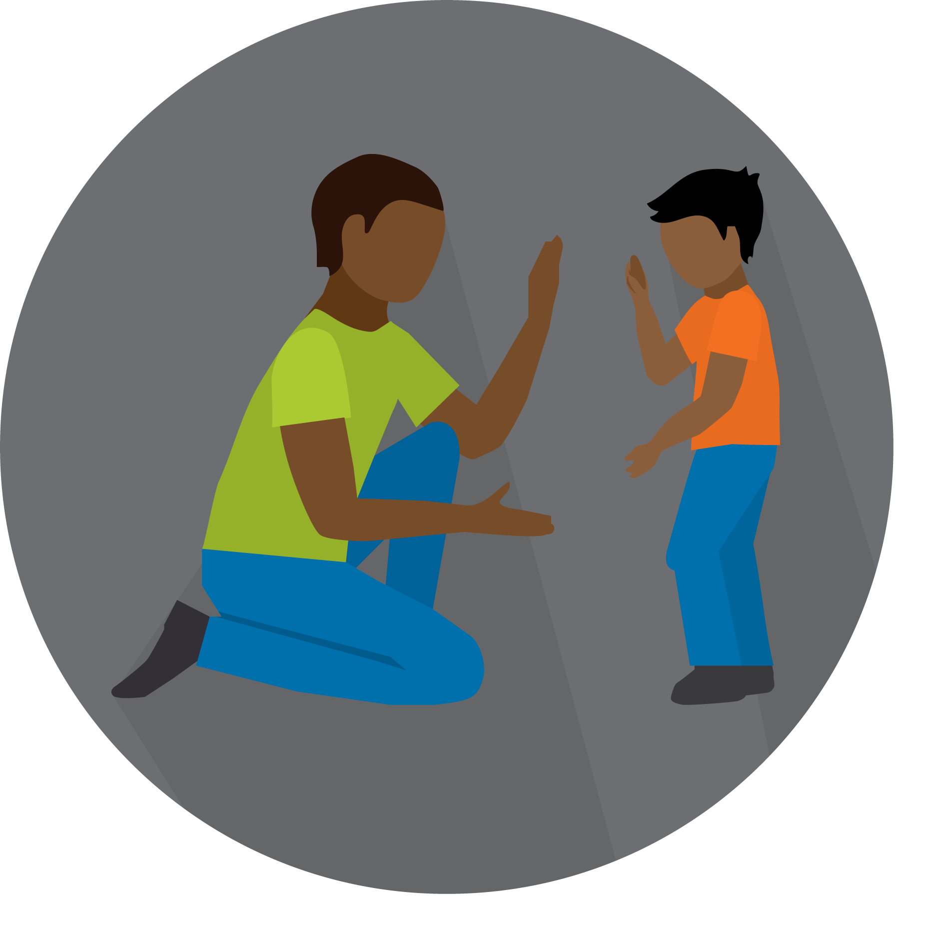
PRACTICE

Slide 51
Practice
Pick one behavior displayed by a child or teen in your home that you find challenging or that you want to increase
Use the behavior worksheet to identify patterns and needs and develop a plan

Slide 52
CLOSING CHECK-IN

Slide 53
What Is Your Energy Right Now?
Totally Comfortable
z
Great Match
+10
+5
0
-5
-10
Really Uncomfortable
Terrible Match

Slide 54
See you next time!

