Slide 1

MODULE THREE
coping with difficult behavior
TST-FC

Slide 2


Welcome Back!
Questions
Review homework
Today we will learn about:
Three phases of challenging behavior —
Revving, re-experiencing and reconstituting
How you can be a powerful, positive presence
in your child’s life

Slide 3
Goals for Today
Participants will be able to | Trainers will help you to
Detect behavioral signals that indicate children are shifting into one of the 4 R’s | Develop skills to understand children’s signals of distress, help them regulate their emotional states and use restorative discipline
Recall at least two strategies that promote emotional regulation in each of the 4 R’s | Increase your understanding of why it is important to get involved early to prevent children’s survival-in-the-moment states
Identify two strategies to use when children are re-experiencing trauma | Improve your ability to respond to children during times of redirection, correction and discipline

Slide 4
Stages of Behavior (the 4 R’s)
 | Regulating | Revving | Re-experiencing | Reconstituting
CHILD BEHAVIOR | Restful. Child is calm and engaged in his or her environment | Vigilant. Child has been triggered and is trying to manage emotions | Fight, flight or freeze. Child’s coping skills are overwhelmed; s/he is struggling | Calming down. Child is beginning to manage emotions and re-engage
YOUR PRIORITY | Minimize triggers to prevent escalation | Help your child regulate emotion | Make sure your efforts to contain the child do not re-traumatize him or her, keep the child and others safe | Help your child continue to manage emotions and re-engage

Slide 5

Revving Is a Critical Time to Help Children Avoid Escalating Into the Re-Experiencing Stage
You can make a difference by recognizing a child’s signals of revving and knowing what to do in response. What you do depends on the signals of revving you are seeing.
What have you seen?

Slide 6

The Power of Our Presence When Children Are Revving

Slide 7
Revving: Now Is the Time to Calm, Not Teach
Focus on the following:
  Identifying when it’s happening
  Being present, with close, good eye contact
  Thinking about what you say
  Thinking about what you do

Slide 8

Revving in Children Is a Vulnerable
Time for Caregivers, Too
When are you most at risk for power plays?
How do you balance?

Slide 9
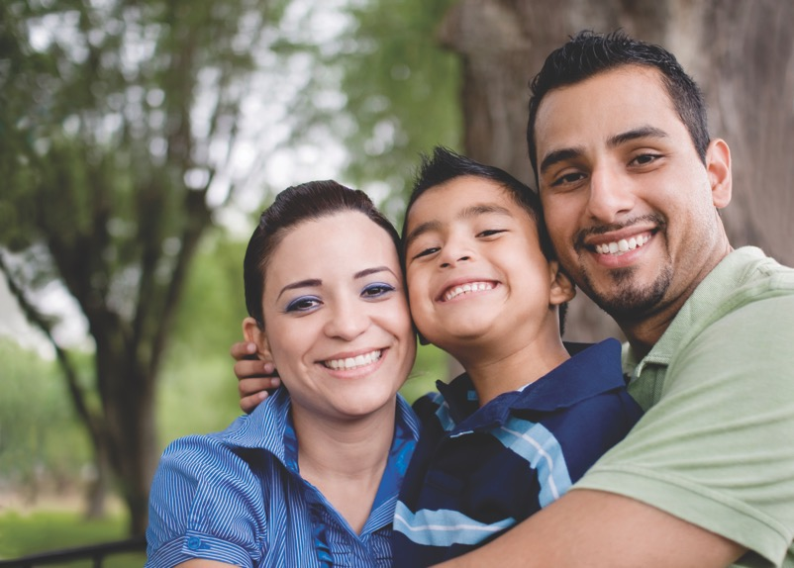
What Is Emotional Regulation?

Slide 10
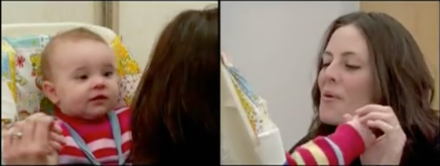
One Video/Two Examples
The Still Face Experiment
  With Mom
  With Dad
https://www.youtube.com/watch?v=apzXGEbZht0
Notes:
Moved this here for flow.

Slide 11

Children Who Do Not Learn How to Manage
Their Feelings Can Get Stuck Emotionally
What does it look like when kids get stuck?
They may do the following:
Lose flexibility in their emotional response
Use substances or other harmful behaviors
Become preoccupied by strong feelings
  Ignore difficult feelings

Slide 12
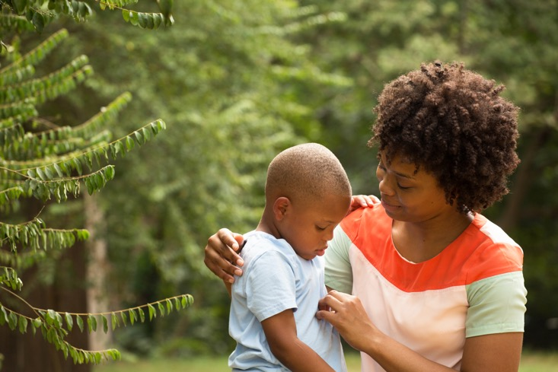
Emotions Are Important and Can
Profoundly Affect Our Actions
Practicing how to manage our feelings promotes lifelong skills

Slide 13

Let’s Talk
Do you currently use any emotional regulation skills in your home? If so, which ones do you find helpful?

Slide 14
Guiding Children and Youth
On the Use of Emotional Regulation Skills
Encourage skills to use around others and when alone
Practice when calm
Use at the first sign
Mix it up
Have skill descriptions handy

Slide 15
New Ways to Exercise
Practice breathing, mindfulness and muscle relaxation exercises on your own and with your kids
If you practice them when kids are calm, they’ll have more skills to draw on when they are upset
Three examples

Slide 16

Emotional Regulation Skills: How and When to Use Them?
Notes:
Nice

Slide 17

Working With Children to Uncover Their Patterns
The Managing Emotions Guide (MEG)

Slide 18

Emotional Regulation Is About
Keeping Our Feelings in Balance
High stress can upset that balance

Slide 19

Emotional Hotspots Can Trigger Revving
What are your family’s hotspots?

Slide 20

How to Say “No”
What have you tried that works?
LET’S PRACTICE

Slide 21

Let’s Talk
Pair up, talk with your partner about:
  One specific goal you have for yourself to work on for the coming week
  Why you want to work on this particular goal
Sample goals: I will try using a softer tone of voice; not shouting from another room; using good eye contact when giving directions; allowing “do-overs”

Slide 22

Re-Experiencing
Notes:
Picture?

Slide 23
Stages of Behavior (the 4 R’s)
 | Regulating | Revving | Re-experiencing | Reconstituting
CHILD BEHAVIOR | Restful. Child is calm and engaged in his or her environment | Vigilant. Child has been triggered and is trying to manage emotions | Fight, flight or freeze. Child’s coping skills are overwhelmed; s/he is struggling | Calming down. Child is beginning to manage emotions and re-engage
YOUR PRIORITY | Minimize triggers to prevent escalation | Help your child regulate emotion | Make sure your efforts to contain the child do not re-traumatize him or her, keep the child and others safe | Help your child continue to manage emotions and re-engage

Slide 24

What to Do When Children
Are Re-Experiencing
Notes:
Picture?

Slide 25
Safety Is Priority #1
If possible, do the following:
  Remove other children from the area
  Try to reduce noise and other stimulation
  Remind the child you are there to help; he or she is safe
  Intervene as soon as possible
  Take three deep breaths; tell yourself something positive (“This isn’t about me. We will get through this.”)
  Stay neutral
  Use short sentences to tell the child what to do; praise
  Use emergency plan, if needed

Slide 26
How to Help When a Child Is in a Survival Response
Ground the child in the here and now
Describe what you see, set limits and offer choices. Use strategies the child identified in their Managing Emotions Guide
Avoid discussing what is making the child angry, panicked or sad. Let the child know you will talk about that once they are calmer
Keep others in the room safe. If possible, ask others to leave the room rather than moving the child
Praise any small movement the child makes toward doing the appropriate thing
Seek help by using your emergency contacts, if needed

Slide 27
What Works When a Child Is Re-Experiencing?
Identify which of three groups you would like to work in: preschool, elementary and secondary
Look at the developmental chart for your age group and talk about what re-experiencing looks like in this age group
Share with each other strategies that have helped when kids are re-experiencing
Discuss your ideas as a large group
Discuss use of calm-down plans for revving and emergency contacts for re-experiencing

Slide 28
Sample of Challenges by Developmental Stages
Preschool | Elementary | Secondary
Struggles to track light or faces | Is frequently sad, worried, afraid or withdrawn | Feels hopeless and unable to make things better
Regularly cries for hours and is very hard to calm | Is easily hurt by peers or bullies others | Withdraws from family or friends
Does not babble or make simple gestures | Is preoccupied with violent movies, TV or games | Often gives in to negative peer pressure
Does not try to move, crawl or explore | Is fearful with familiar adults — or too friendly with strangers | Becomes violent or abusive
Seems overly fearful, even in safe situations | Has strong negative thoughts of him- or herself | Drives aggressively or speeds or drinks and drives
Is extremely aggressive and hostile toward peers | Has an extreme need for approval or support | Has a favorable attitude toward drug abuse
Has trouble expressing emotions | Had highly conflicted relationships | Diets aggressively even when not overweight

Slide 29
Reconstituting
Eventually children will return to baseline

Slide 30

Restorative Practices vs. Punishment
Hearing from you

Slide 31

Introducing Time-In
Time-in works by keeping the child nearby
and under close supervision after a meltdown or difficult behavior

Slide 32
How Time-In Works
The child sits in a “Let’s think about it” spot
Ask the child to think about the situation, what went wrong and how they could have acted
When the child says “Ready,” ask them to describe what could have been done differently. Listen closely, at the child’s level. Make eye contact and respond with a kind but firm voice
You and the child role play how to do it next time
Praise the child for doing it correctly during role play

Slide 33
The Benefits of Restorative Discipline
Giving consequences when kids are revving or re-experiencing can lead to further escalation
Harsh punishment may re-traumatize kids
Kids need boundaries, limits and structure —
but how you provide them is key

Slide 34


Homework and Questions
Homework
Practice your behavioral goals
Questions
Put question in the question box, or
Email one of us

Slide 35

Next Session
Date and time
Place

